Slide 1

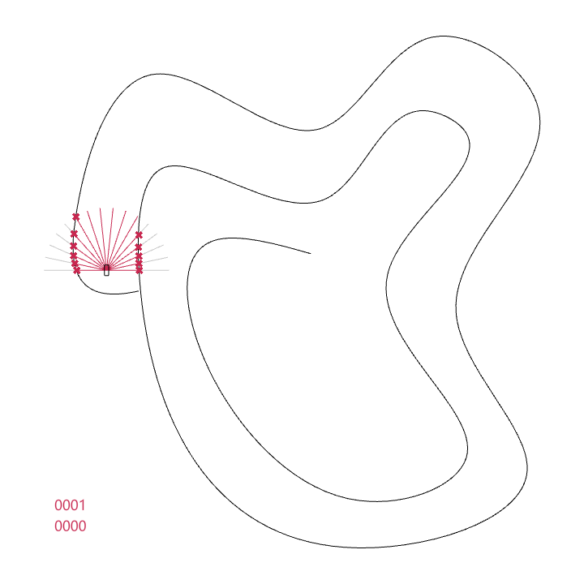
EPISODE
ITERATION

Slide 2


Slide 3


Slide 4
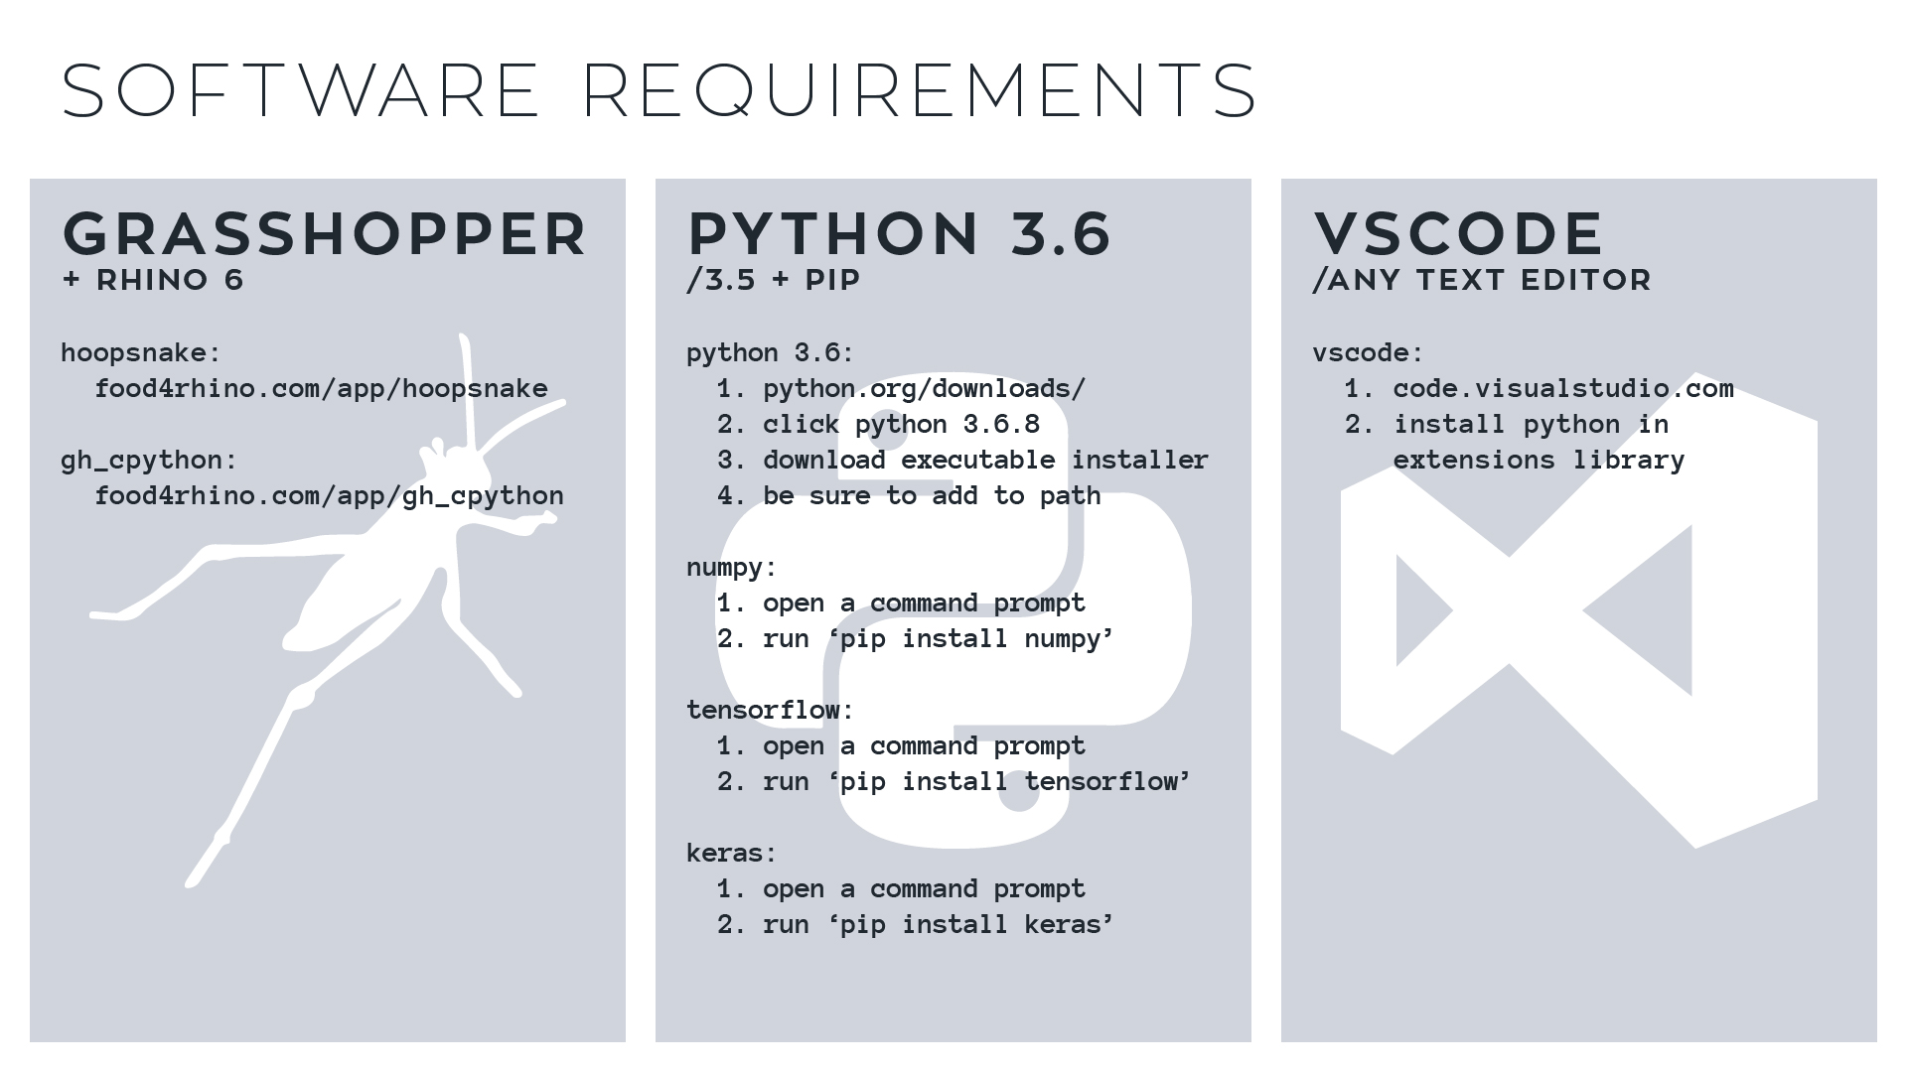
Notes:
- To get rid of green squiggly line, click Ctrl + Shift + p, type ‘Python: Change Linter’, and select ‘Disable Linter’.
- To change shell, open settings, search ‘Terminal Windows’, type in ‘C:\WINDOWS\System32\cmd.exe’

Slide 5
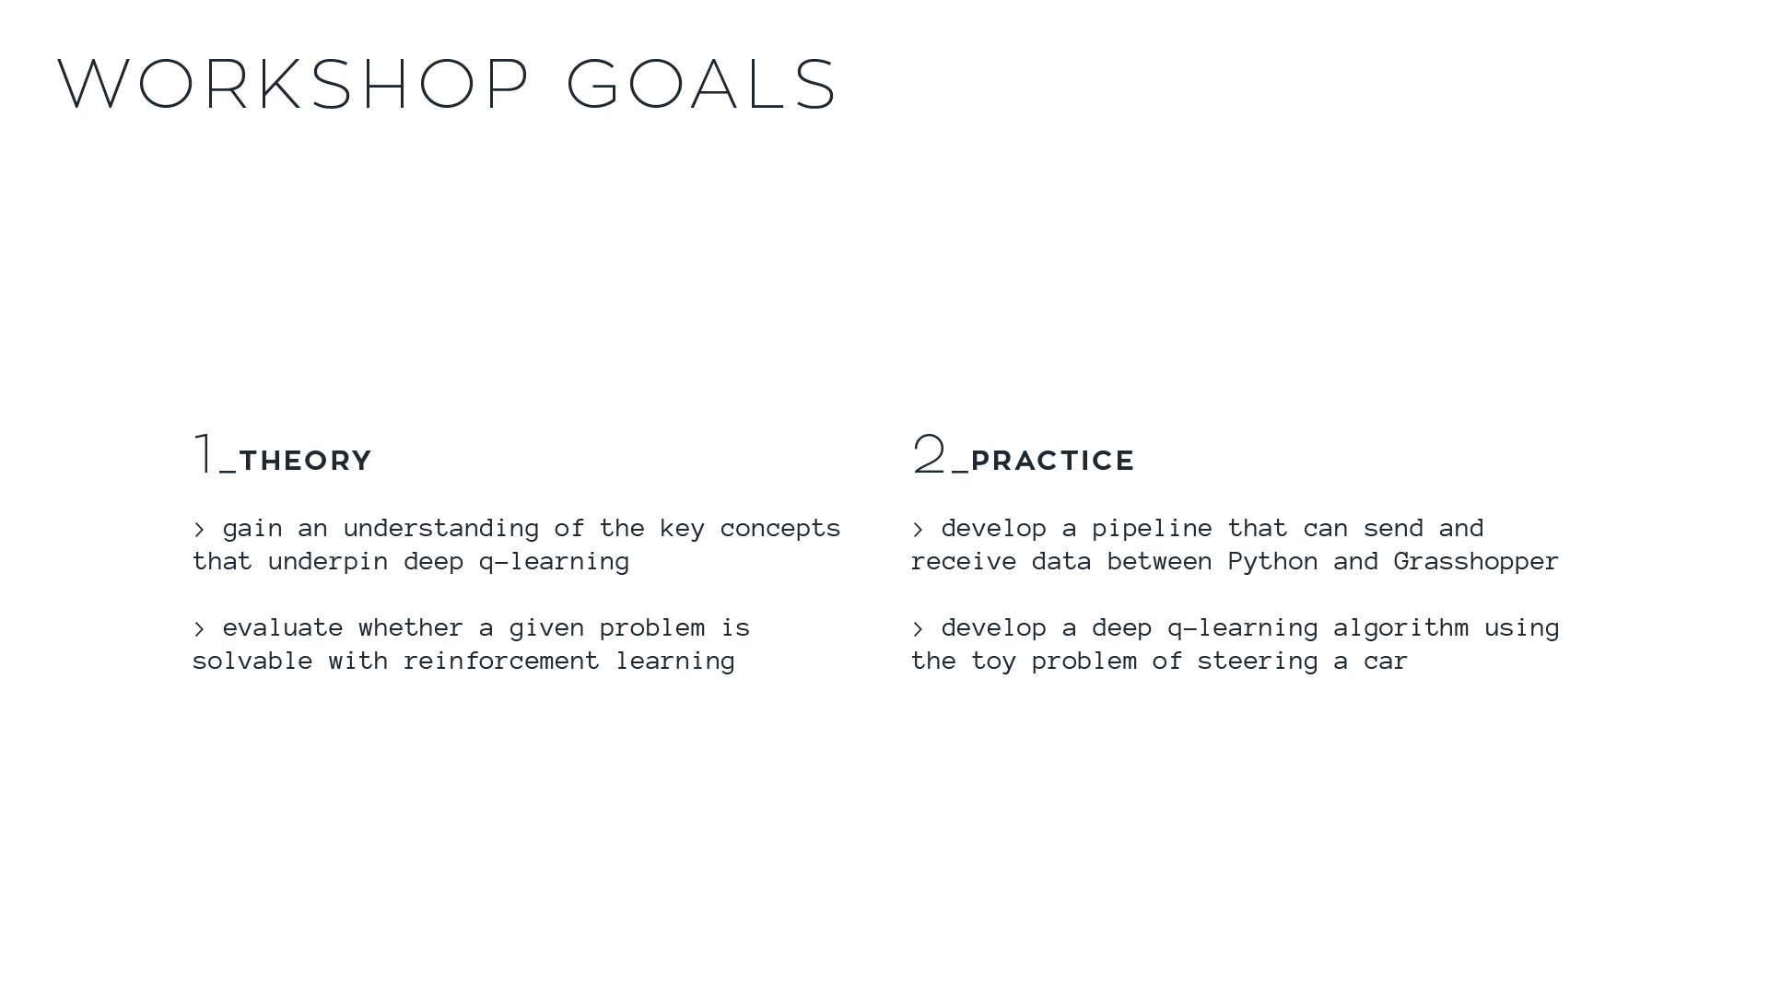

Slide 6
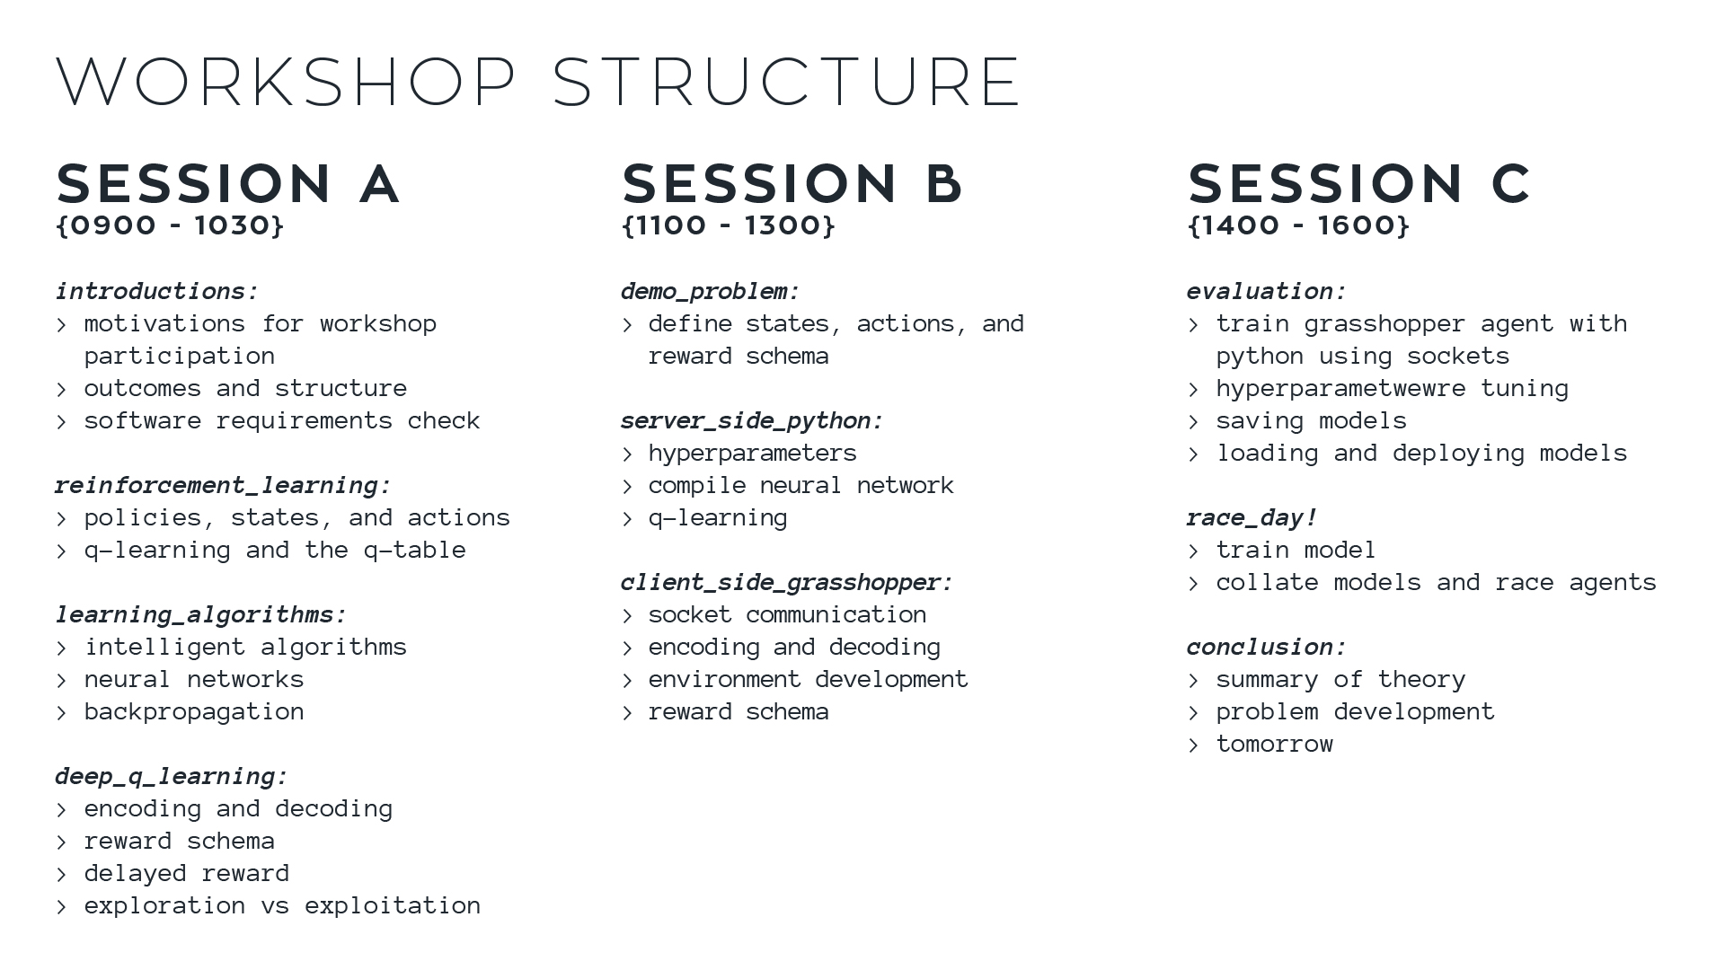

Slide 7


Slide 8


Slide 9


Slide 10


Slide 11
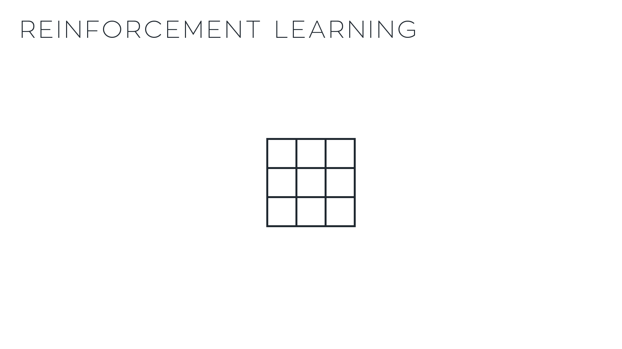
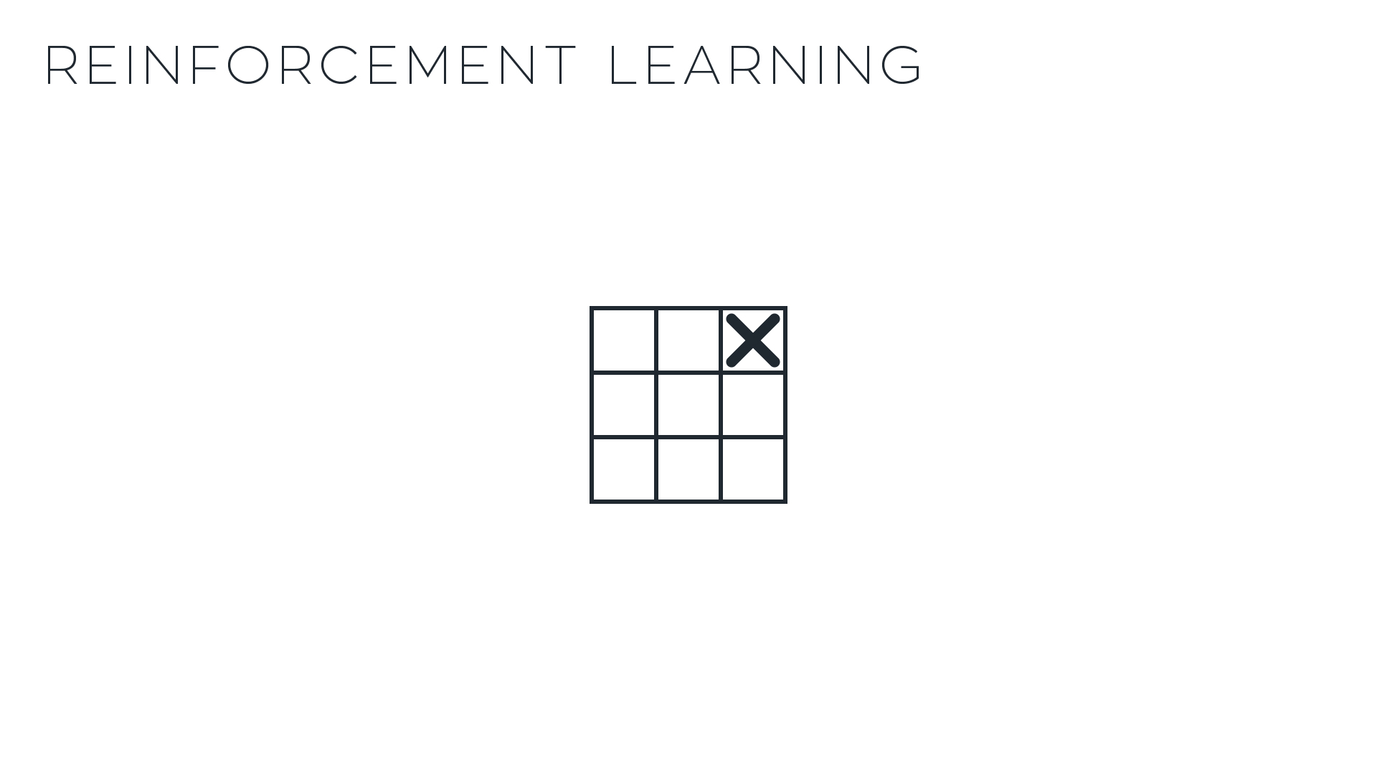








Slide 12




Slide 13
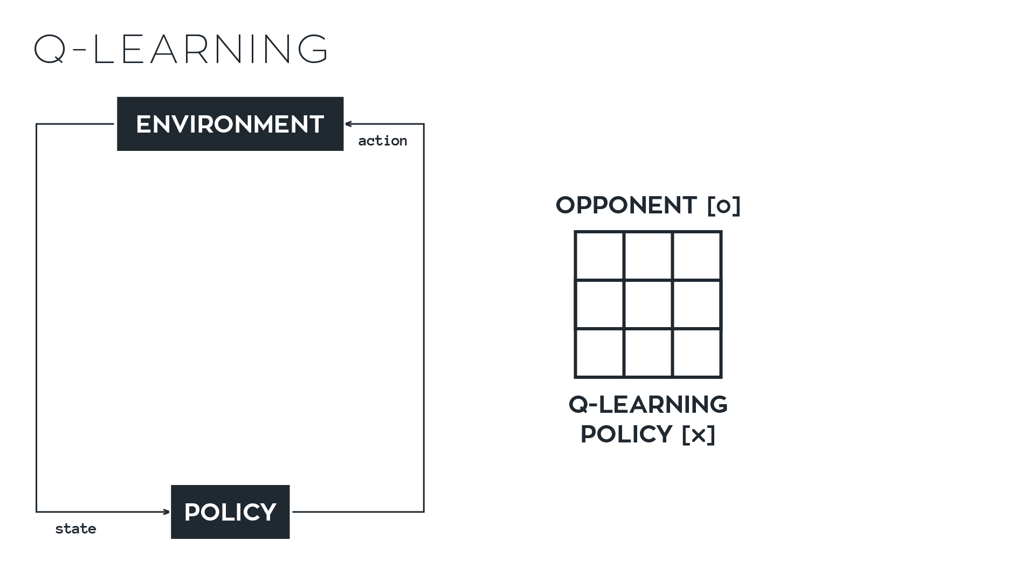
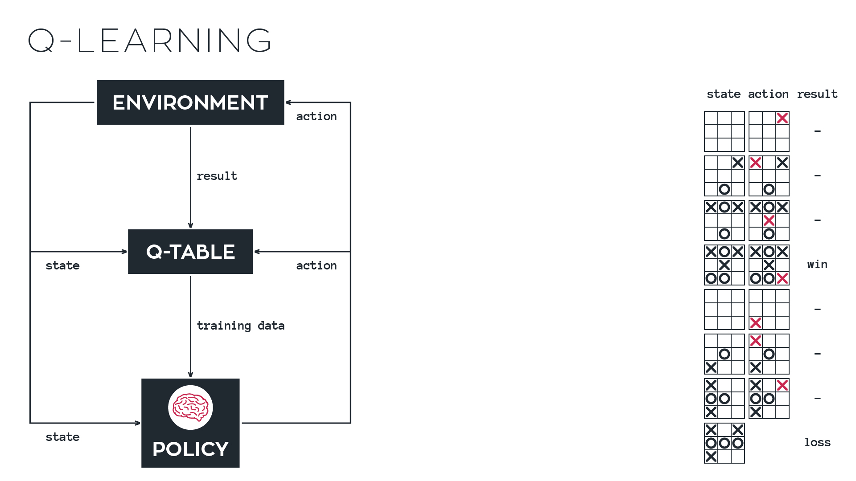

Slide 15
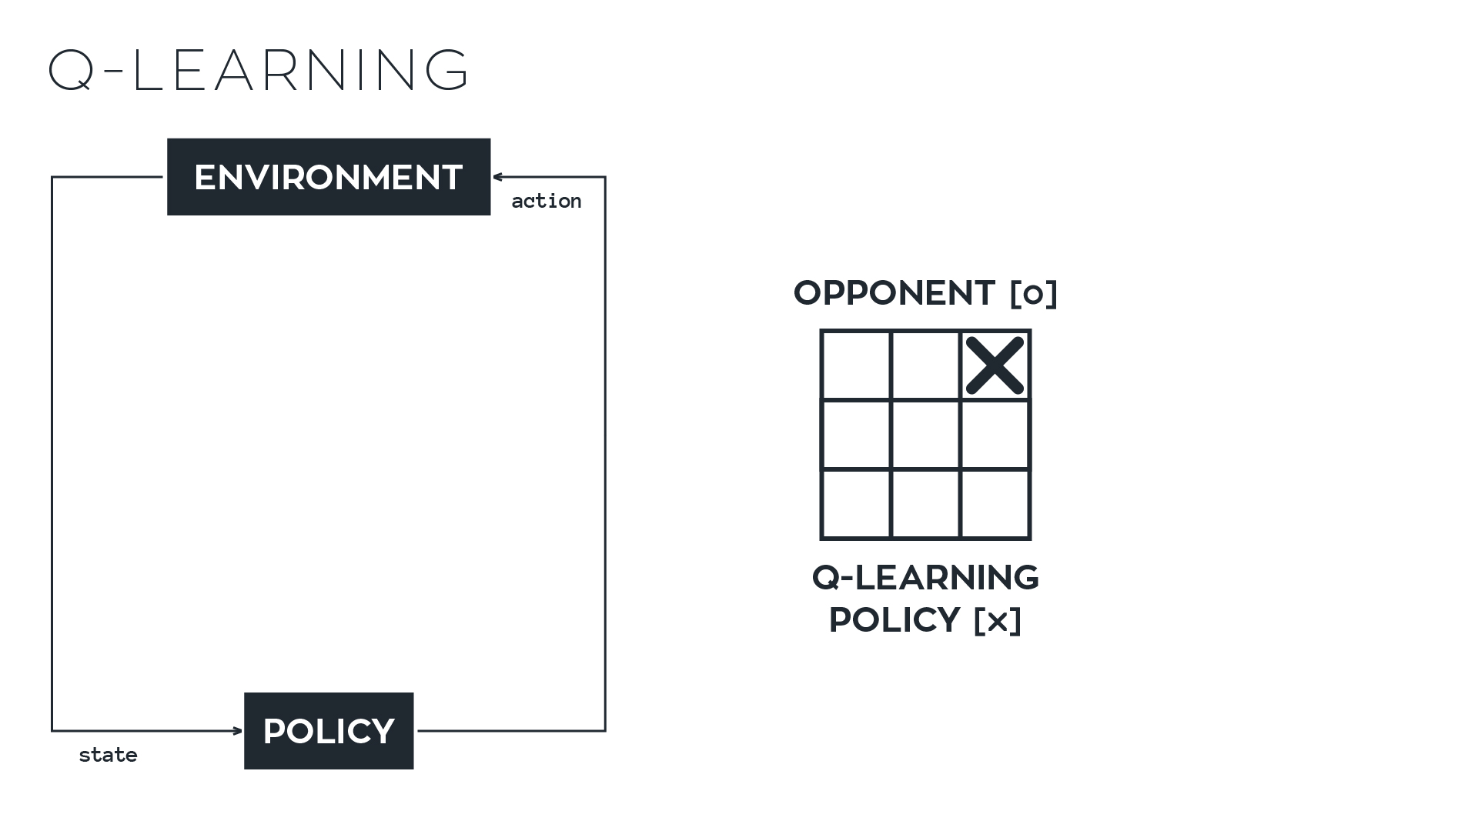

Slide 16
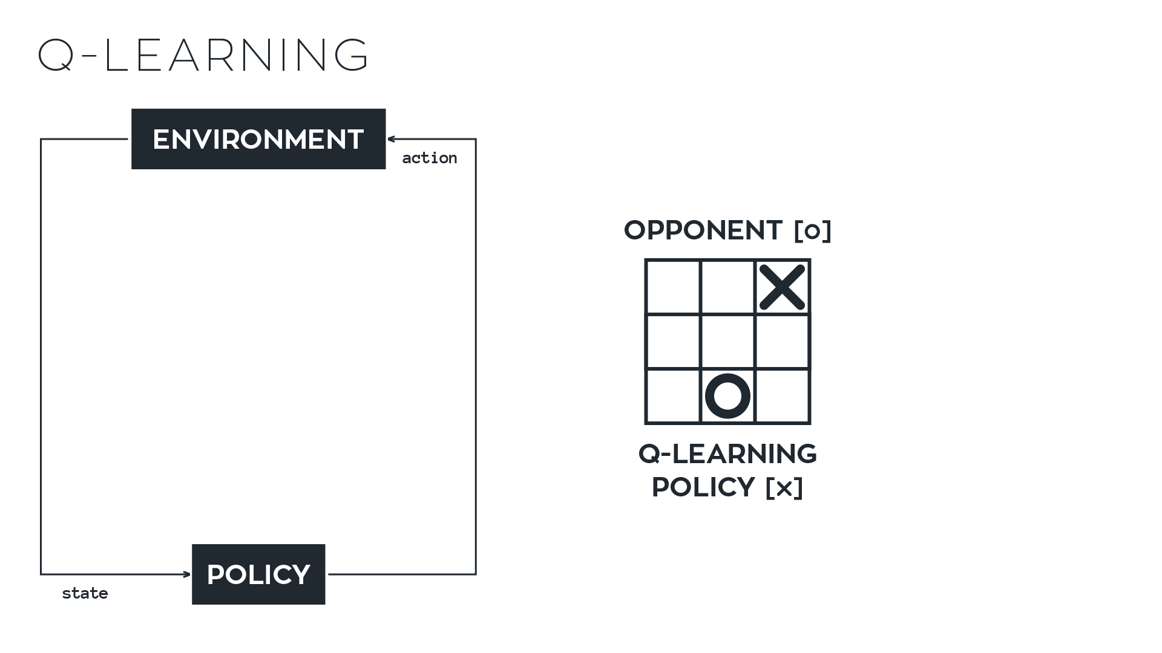

Slide 18
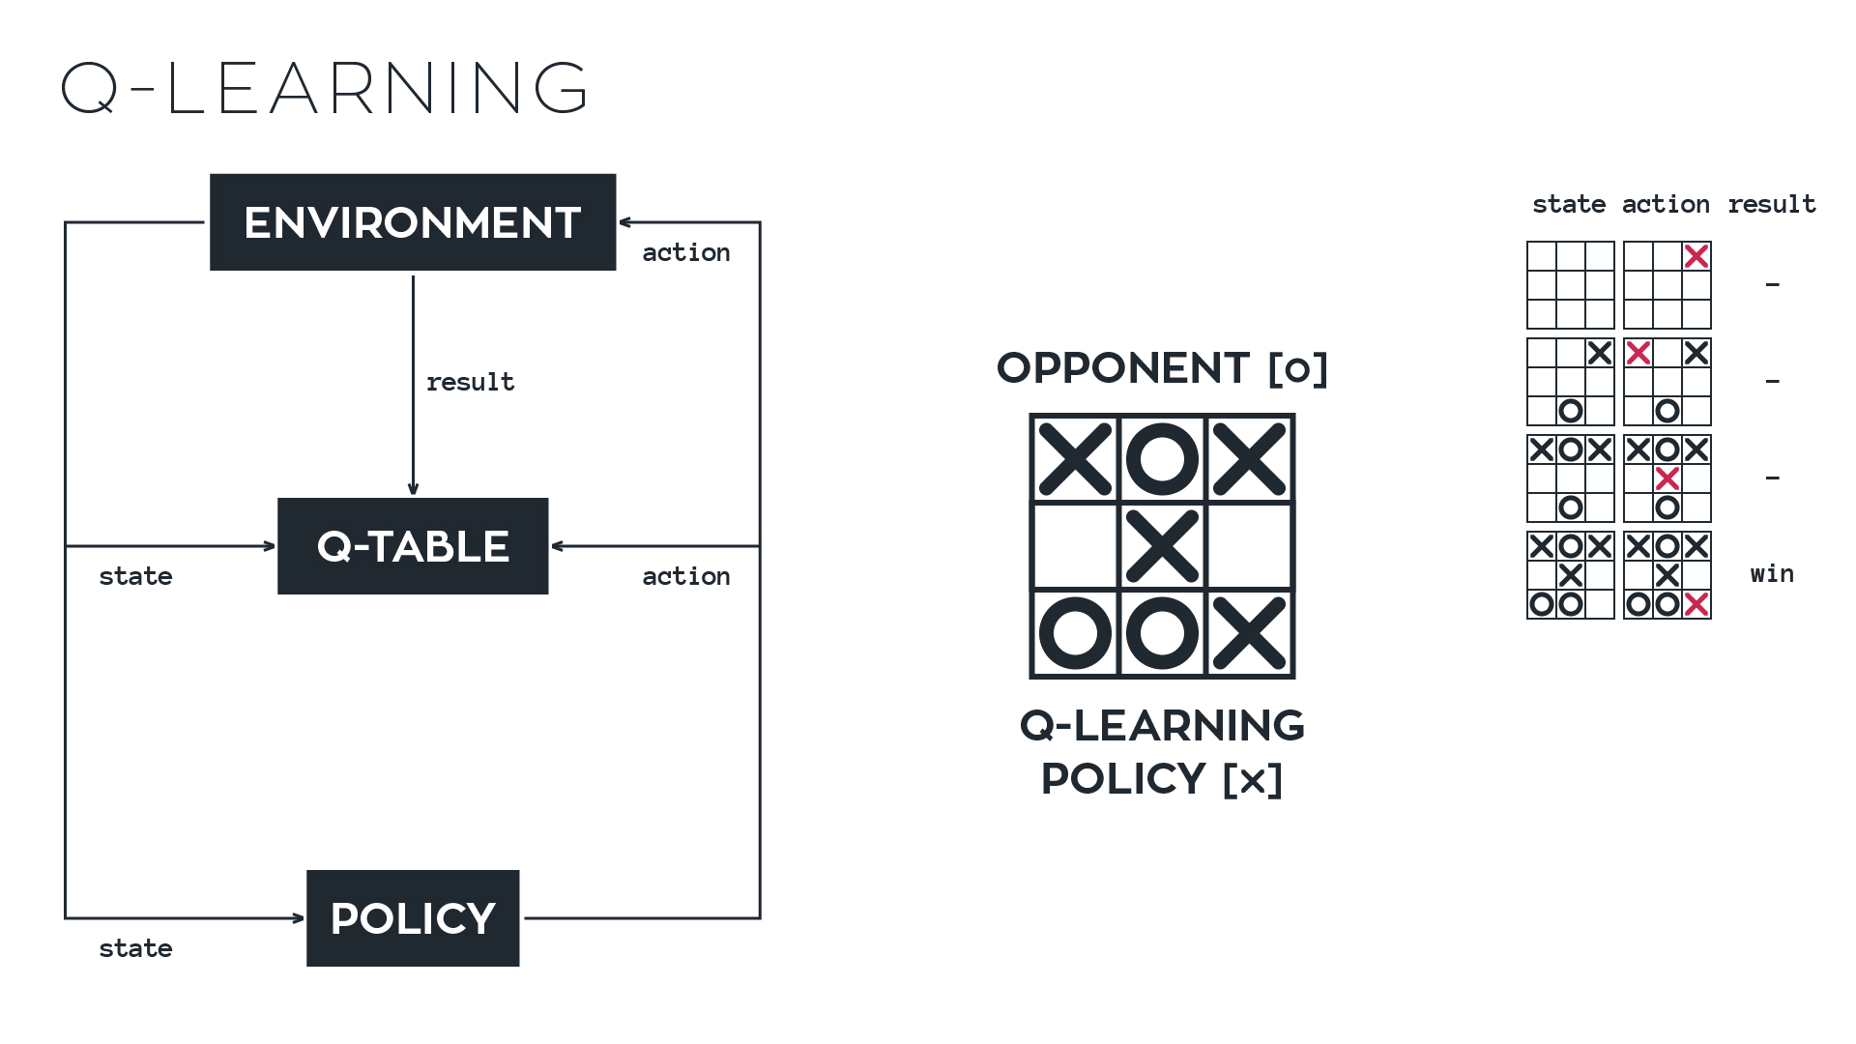

Slide 28
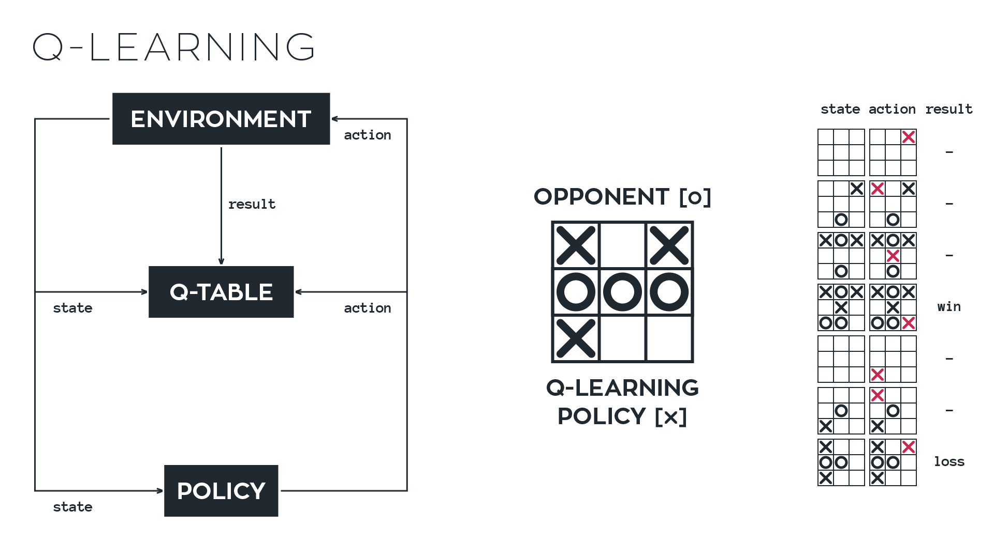

Slide 32

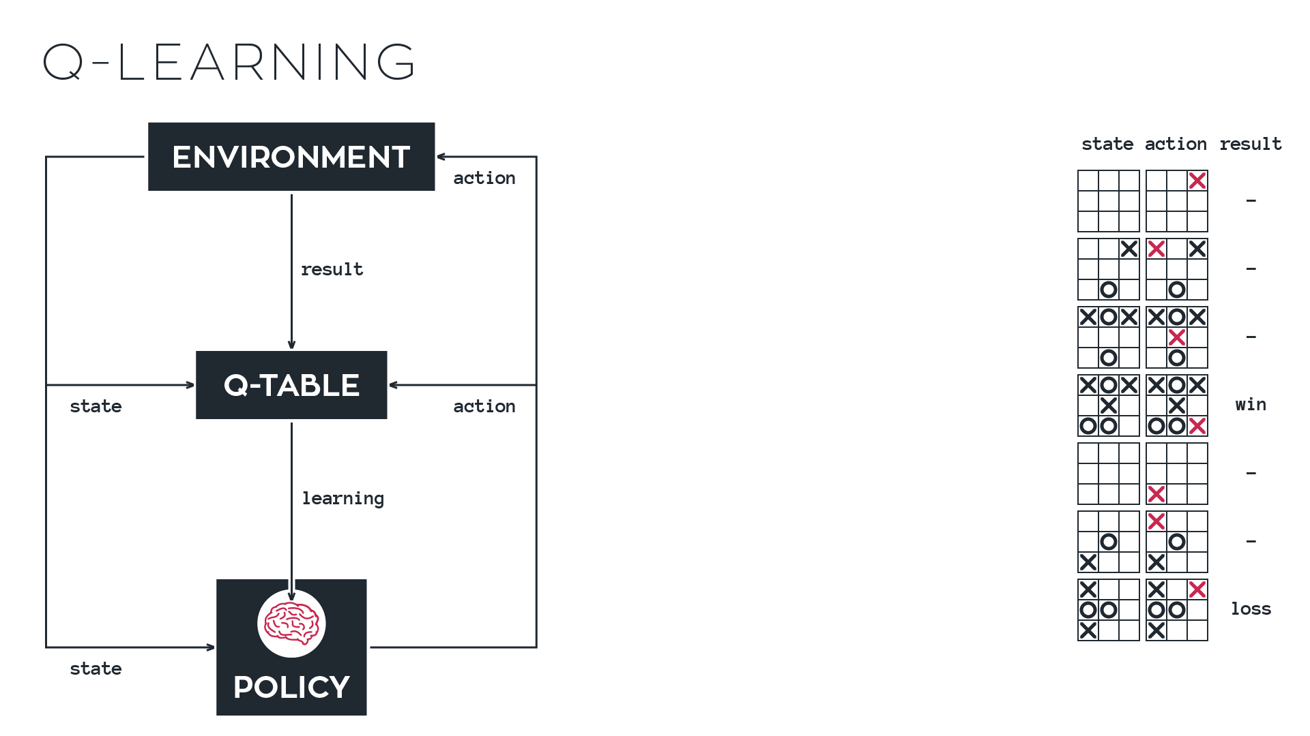

Slide 33
Notes:
Questions?

Slide 34
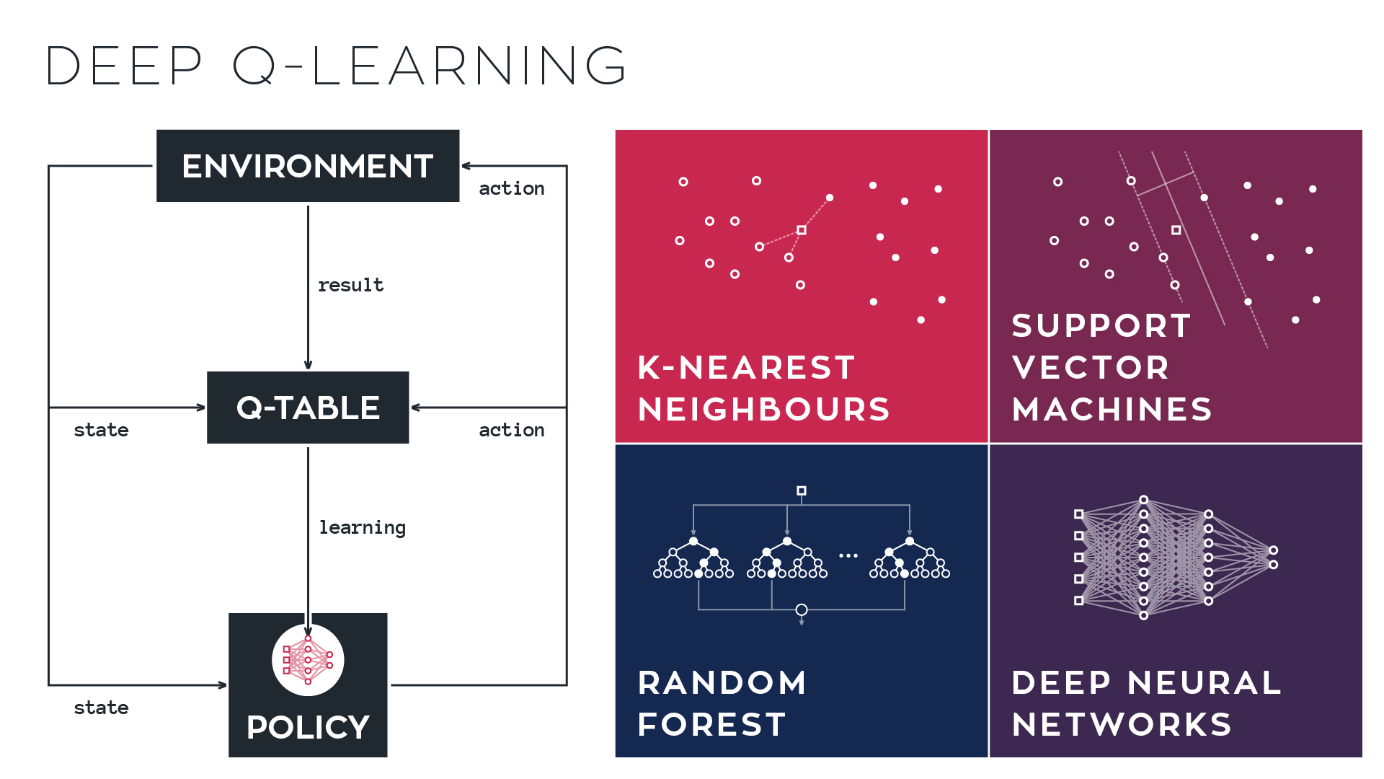


Slide 36


Slide 38


Slide 39
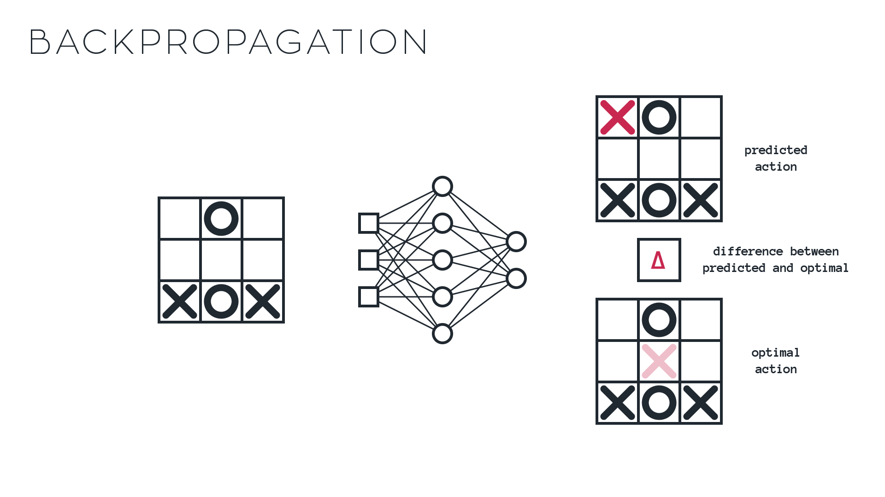
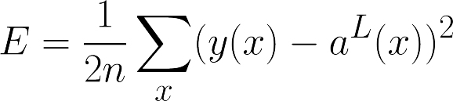
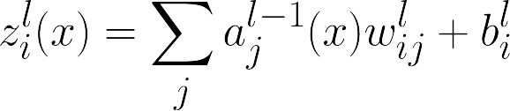
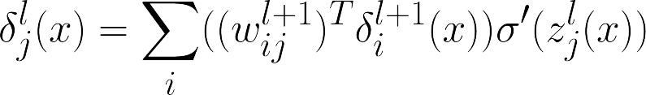
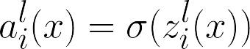

Slide 40
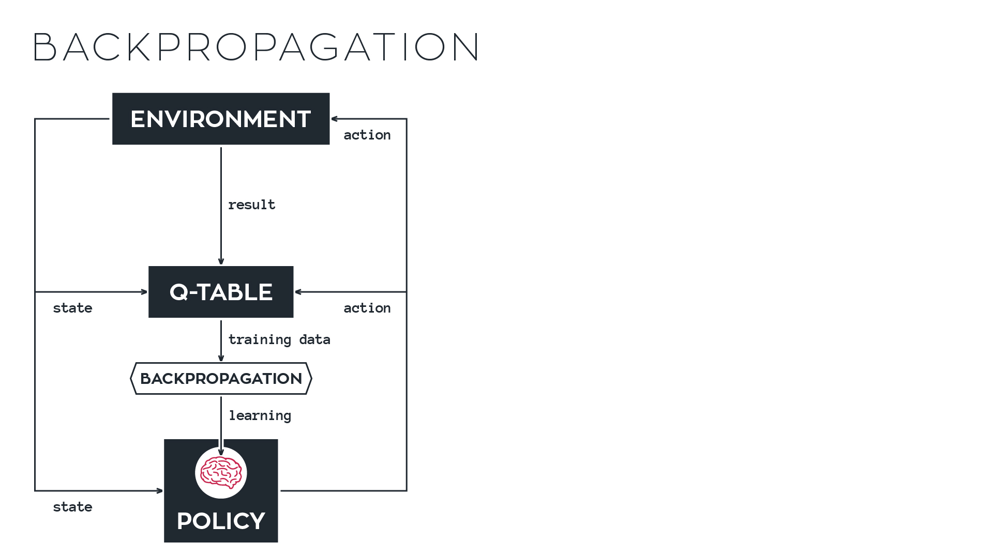

Slide 42
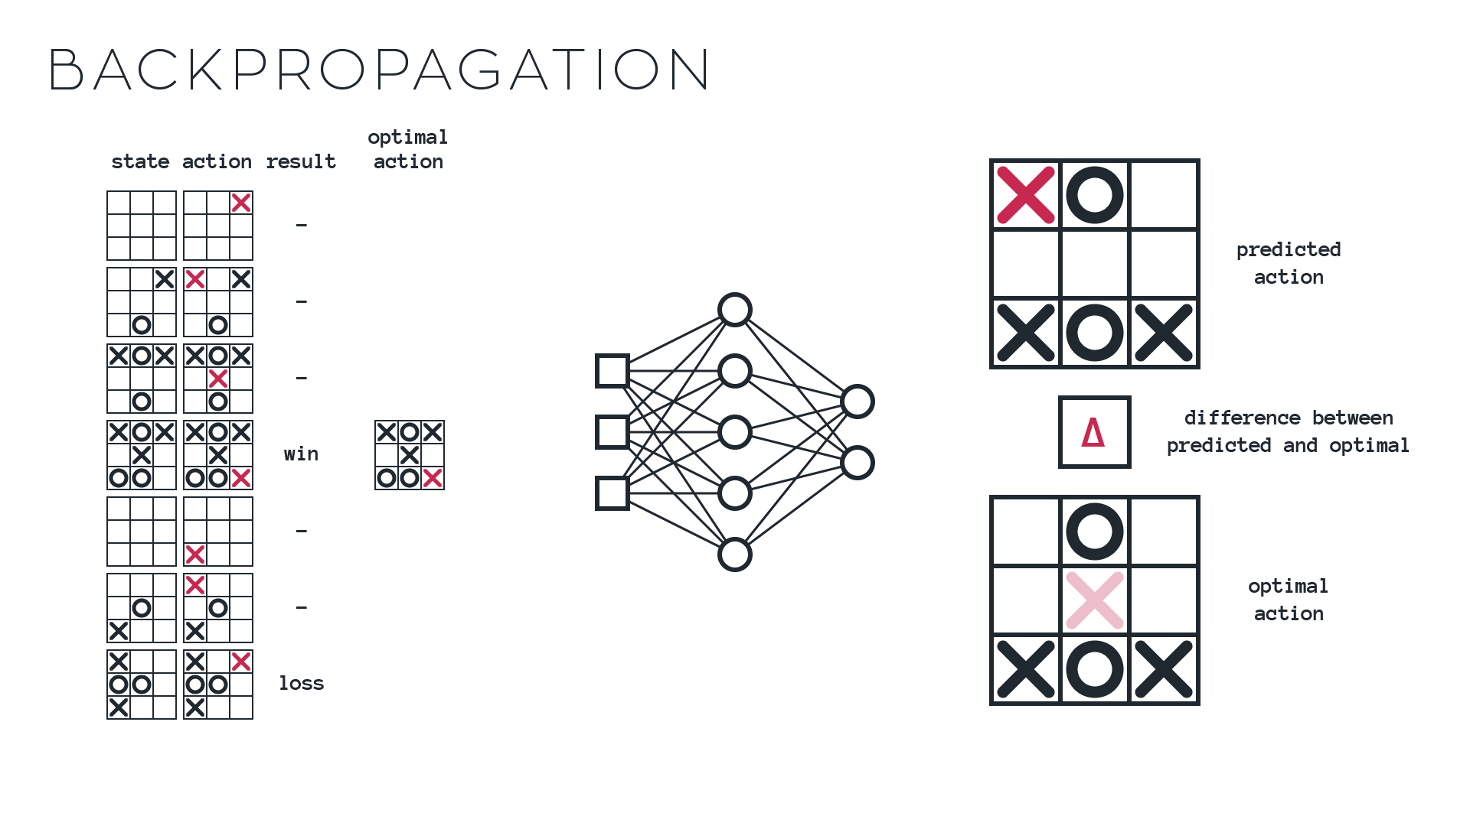

Slide 43


Slide 44


Slide 45


Slide 46


Slide 47
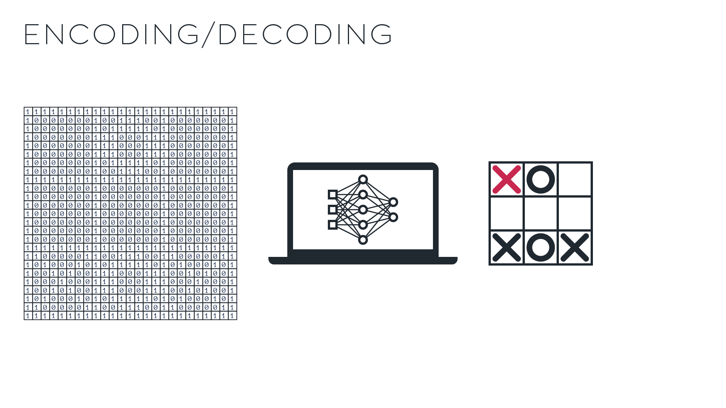

Slide 49

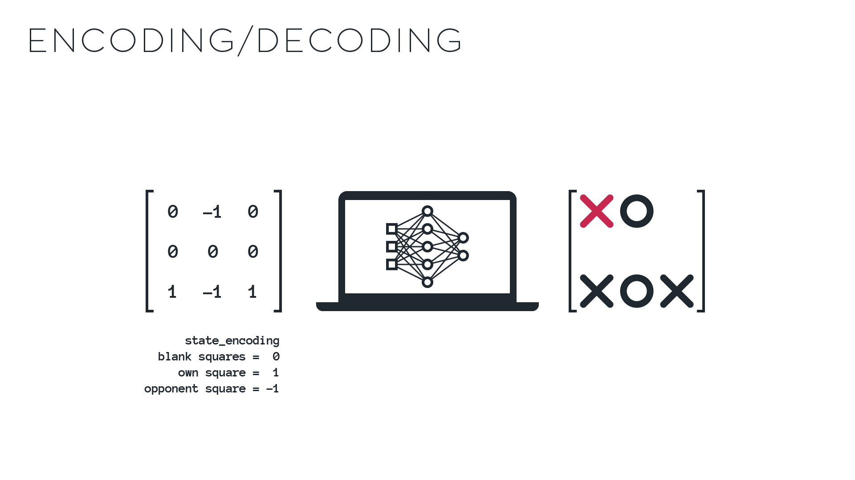

Slide 50
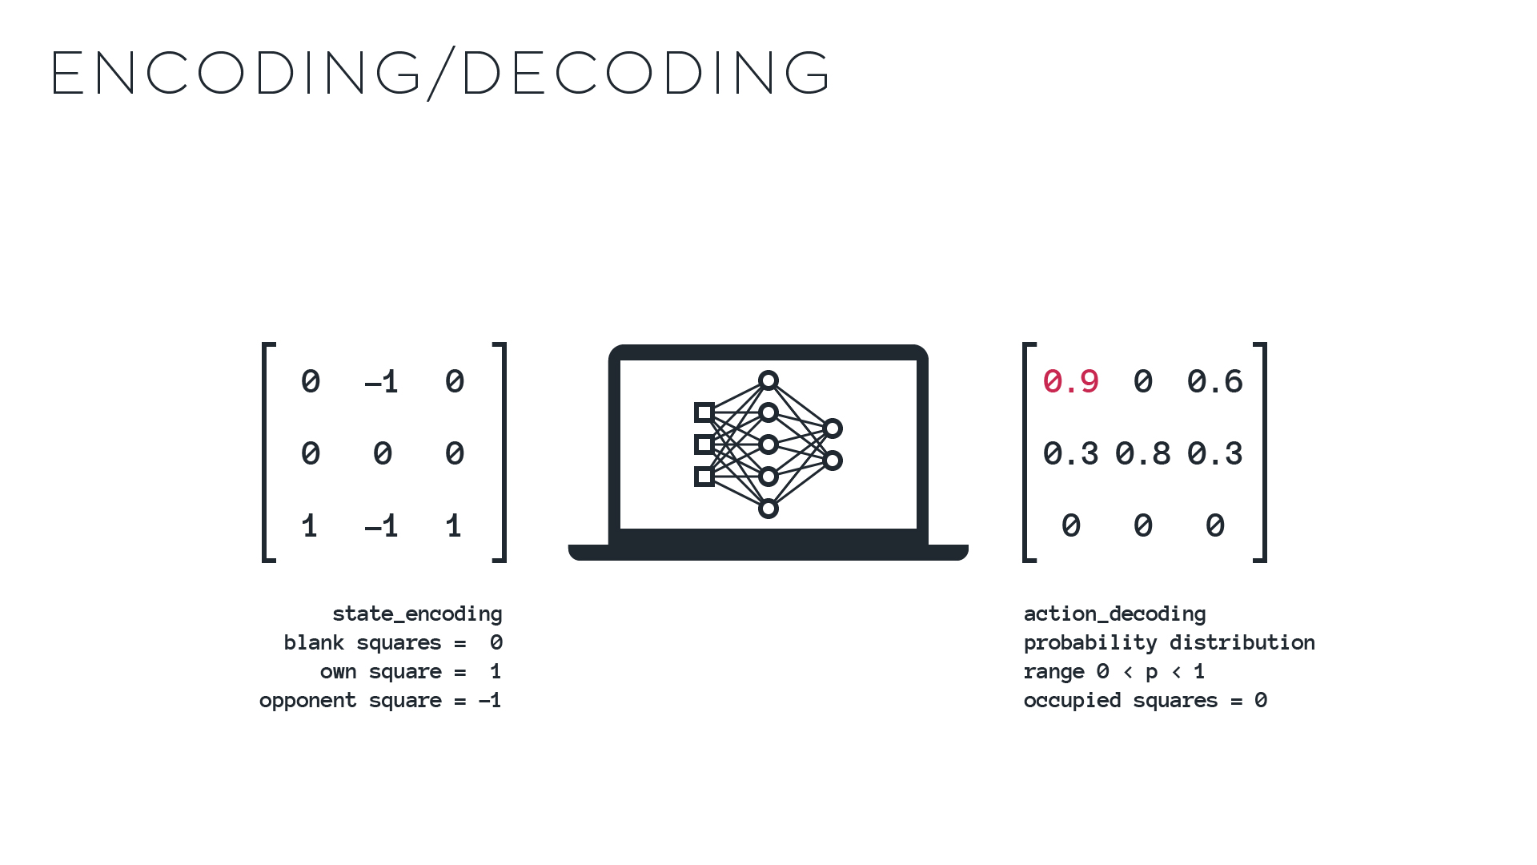

Slide 51
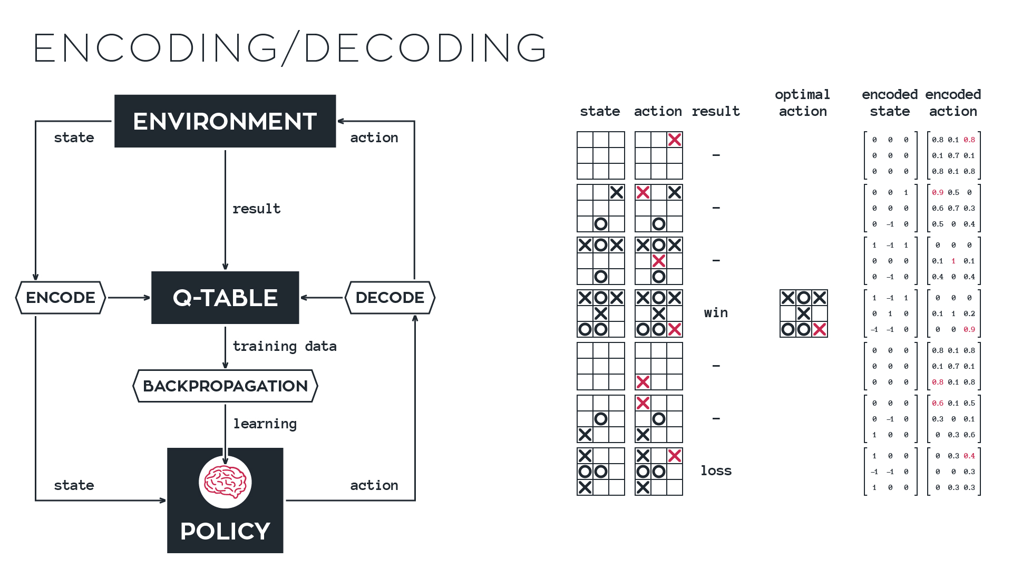
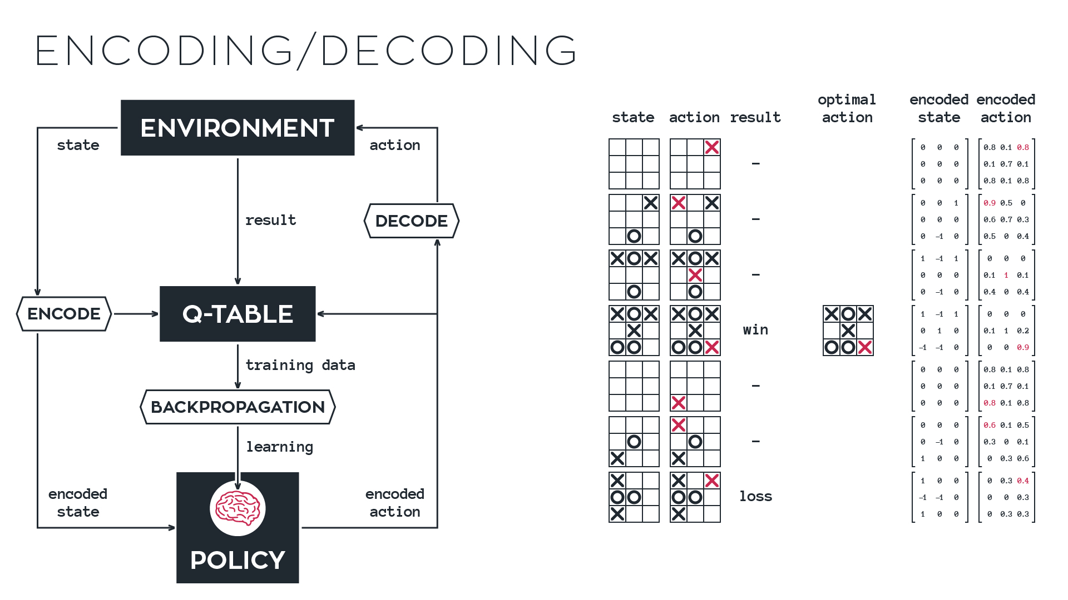
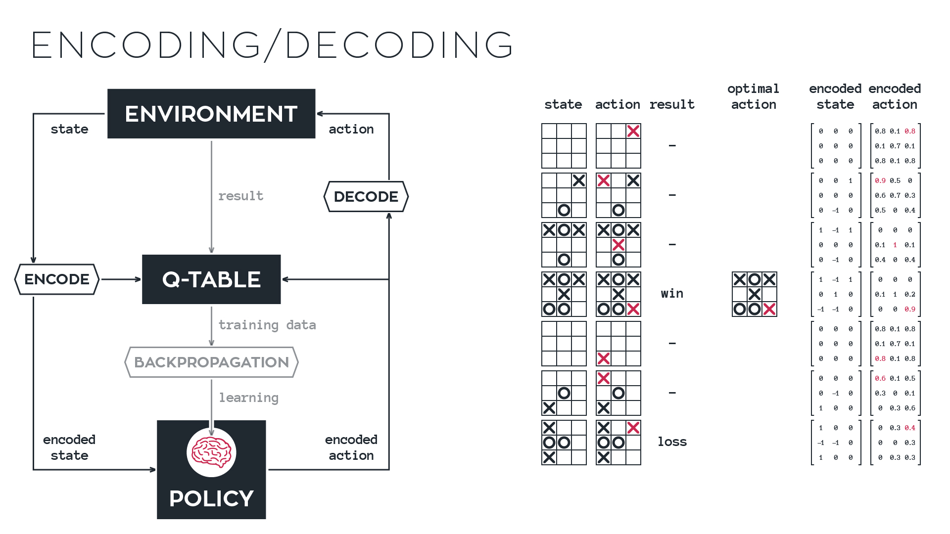
Notes:
Questions?
So, remember, our current goal is to find the optimal action.
We’ve taken the first step of encoding our data.
Next is to explore these intermediate steps.

Slide 52


Slide 53
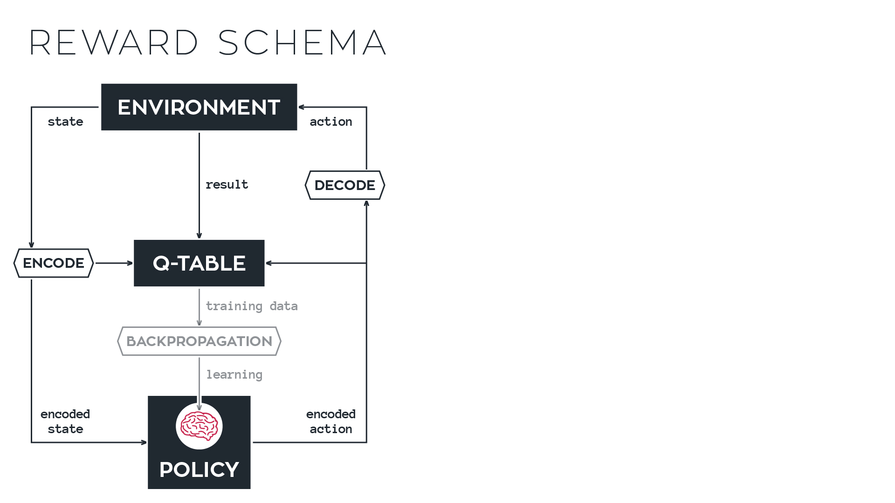

Slide 54
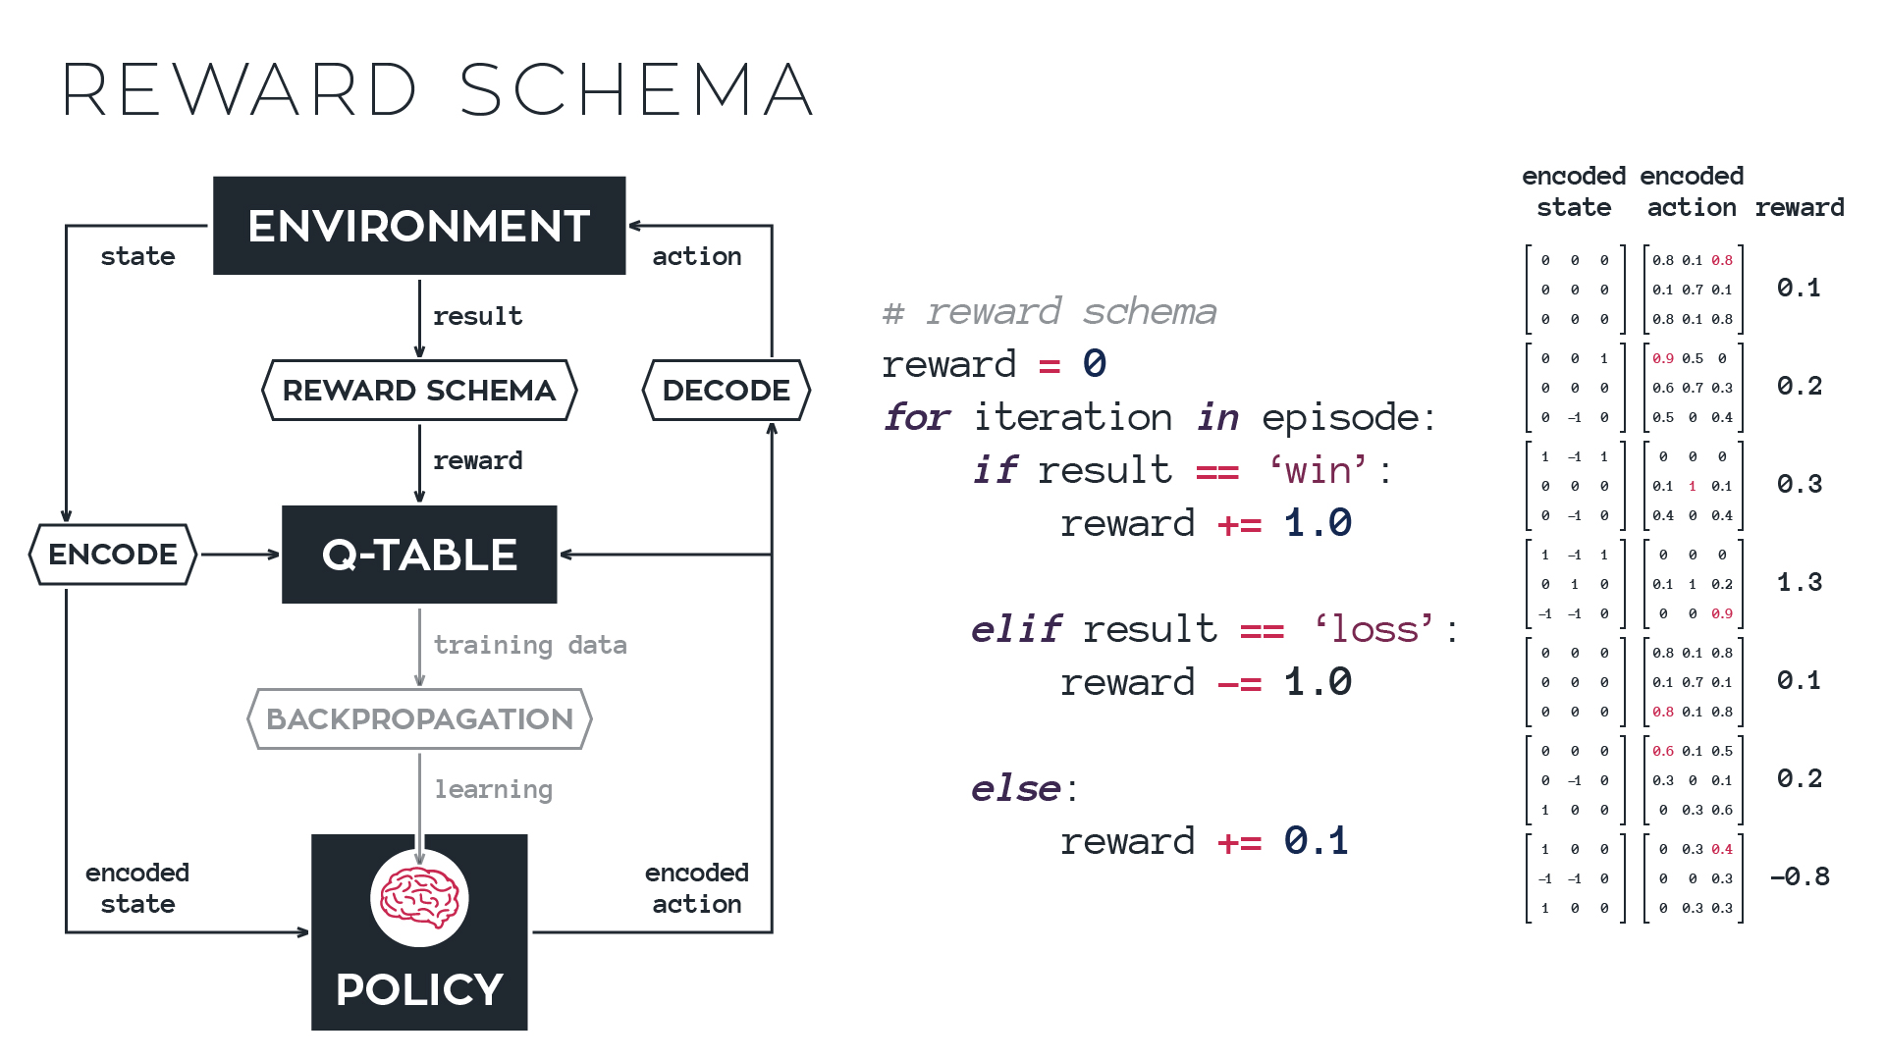

Slide 62
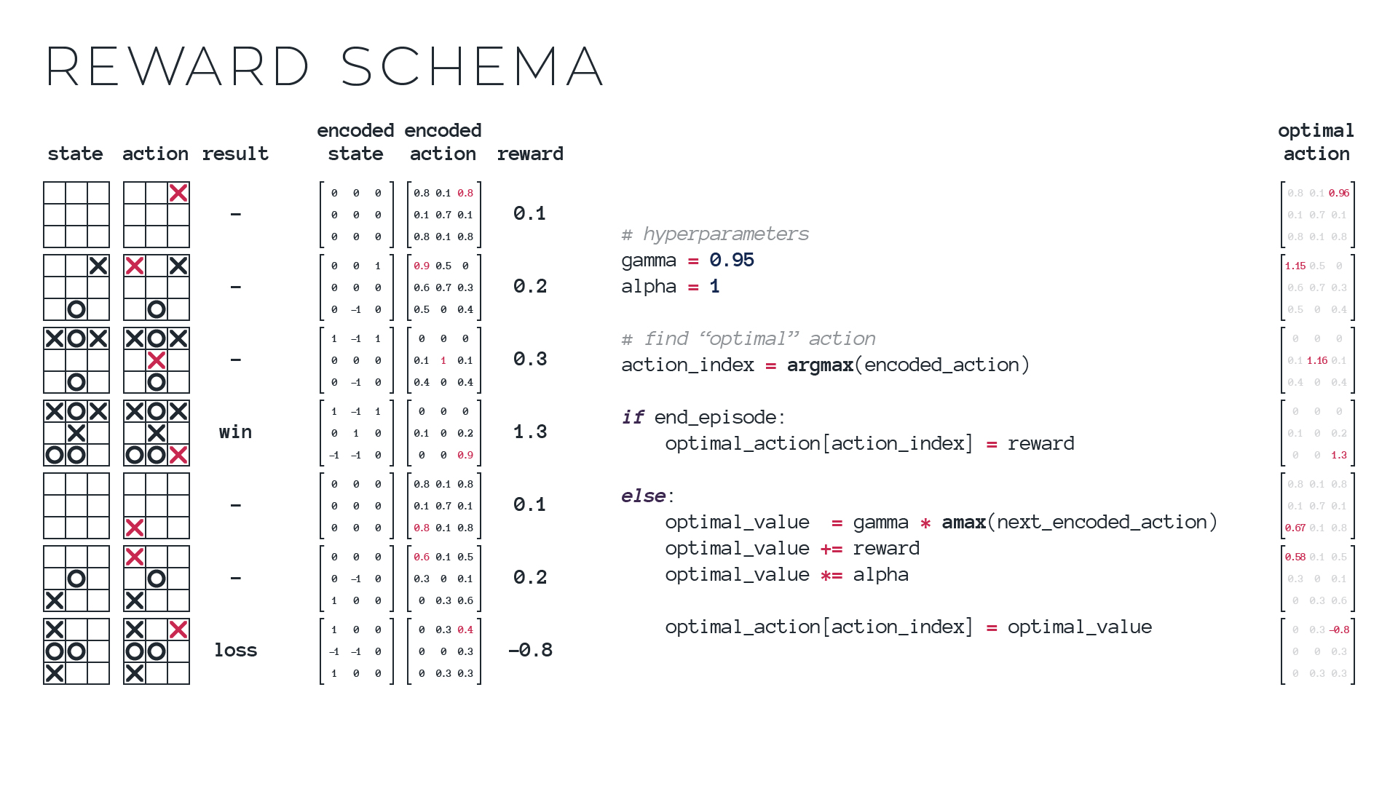
Notes:
Questions

Slide 63



Slide 64
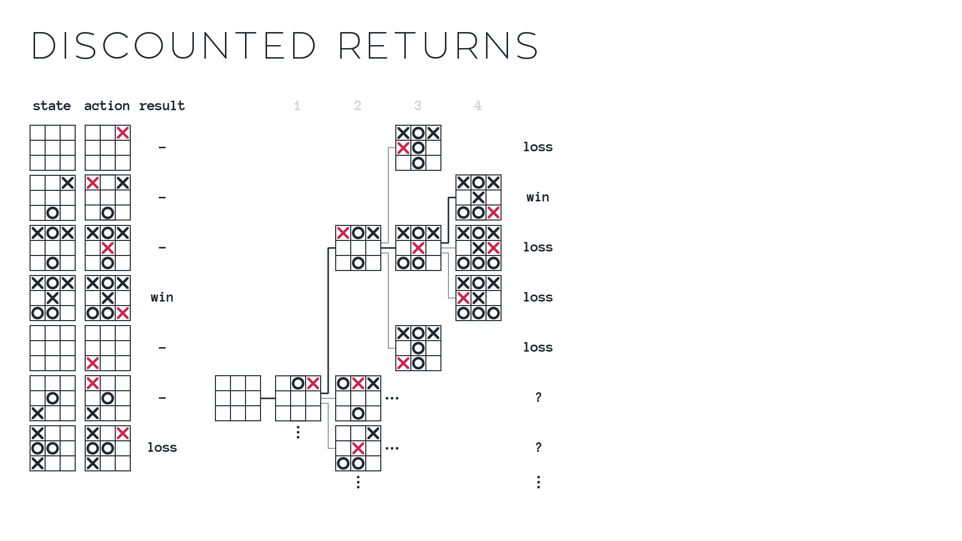
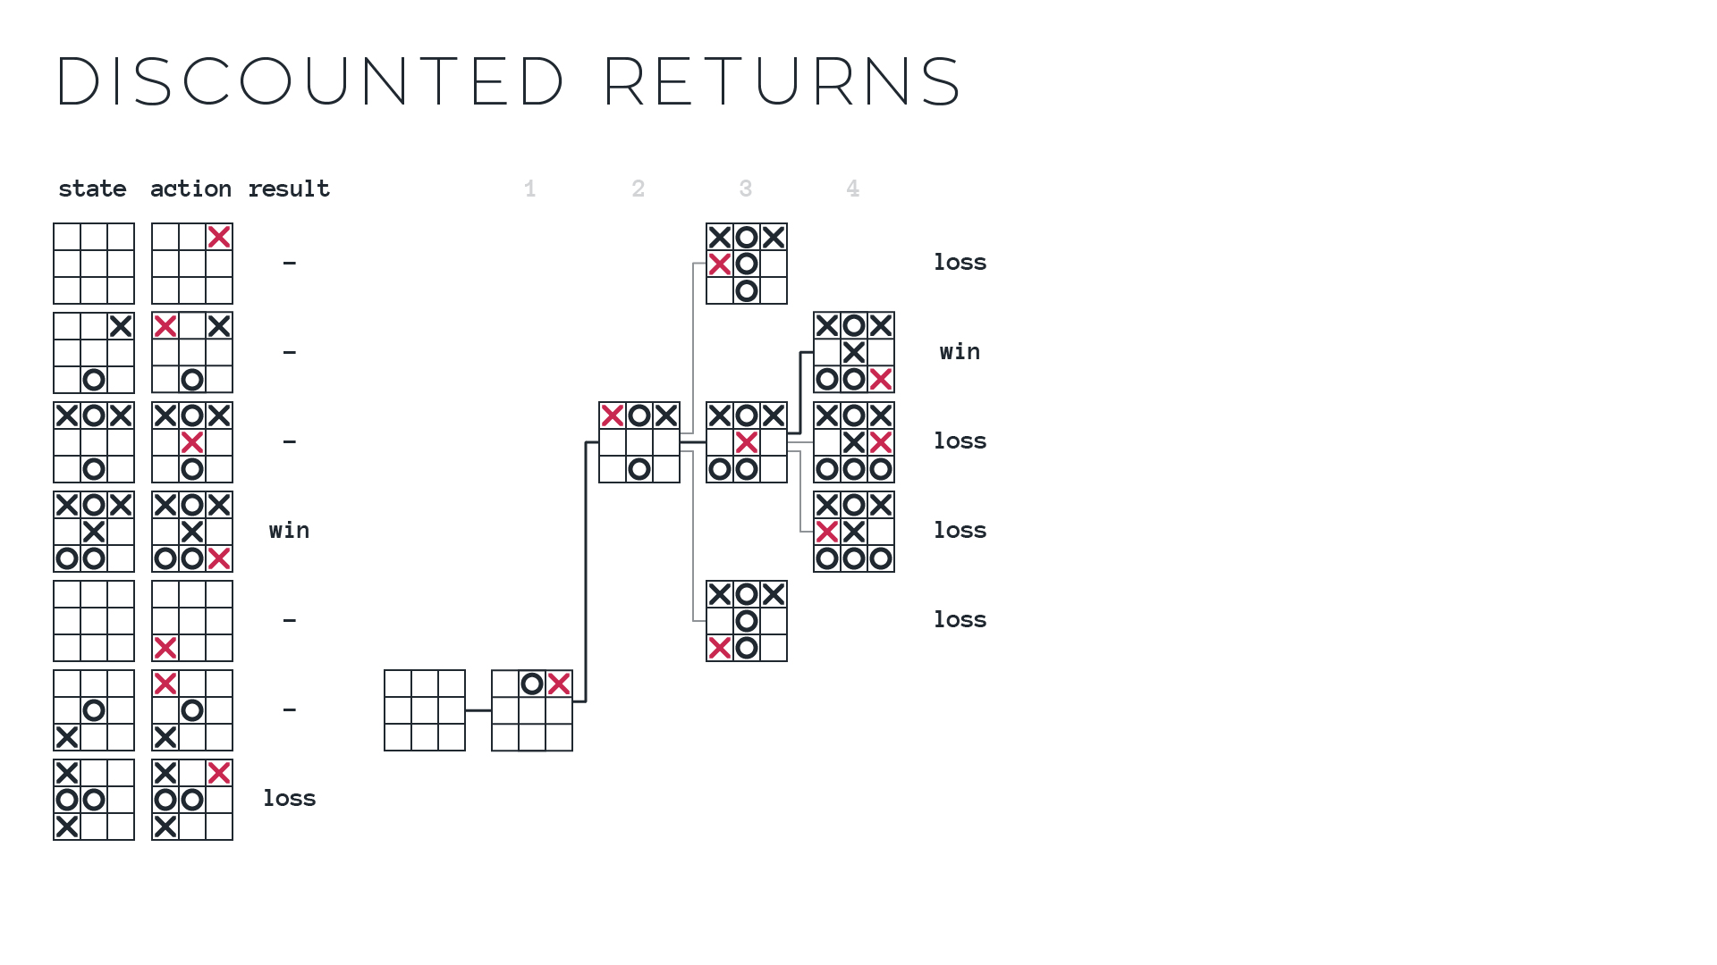
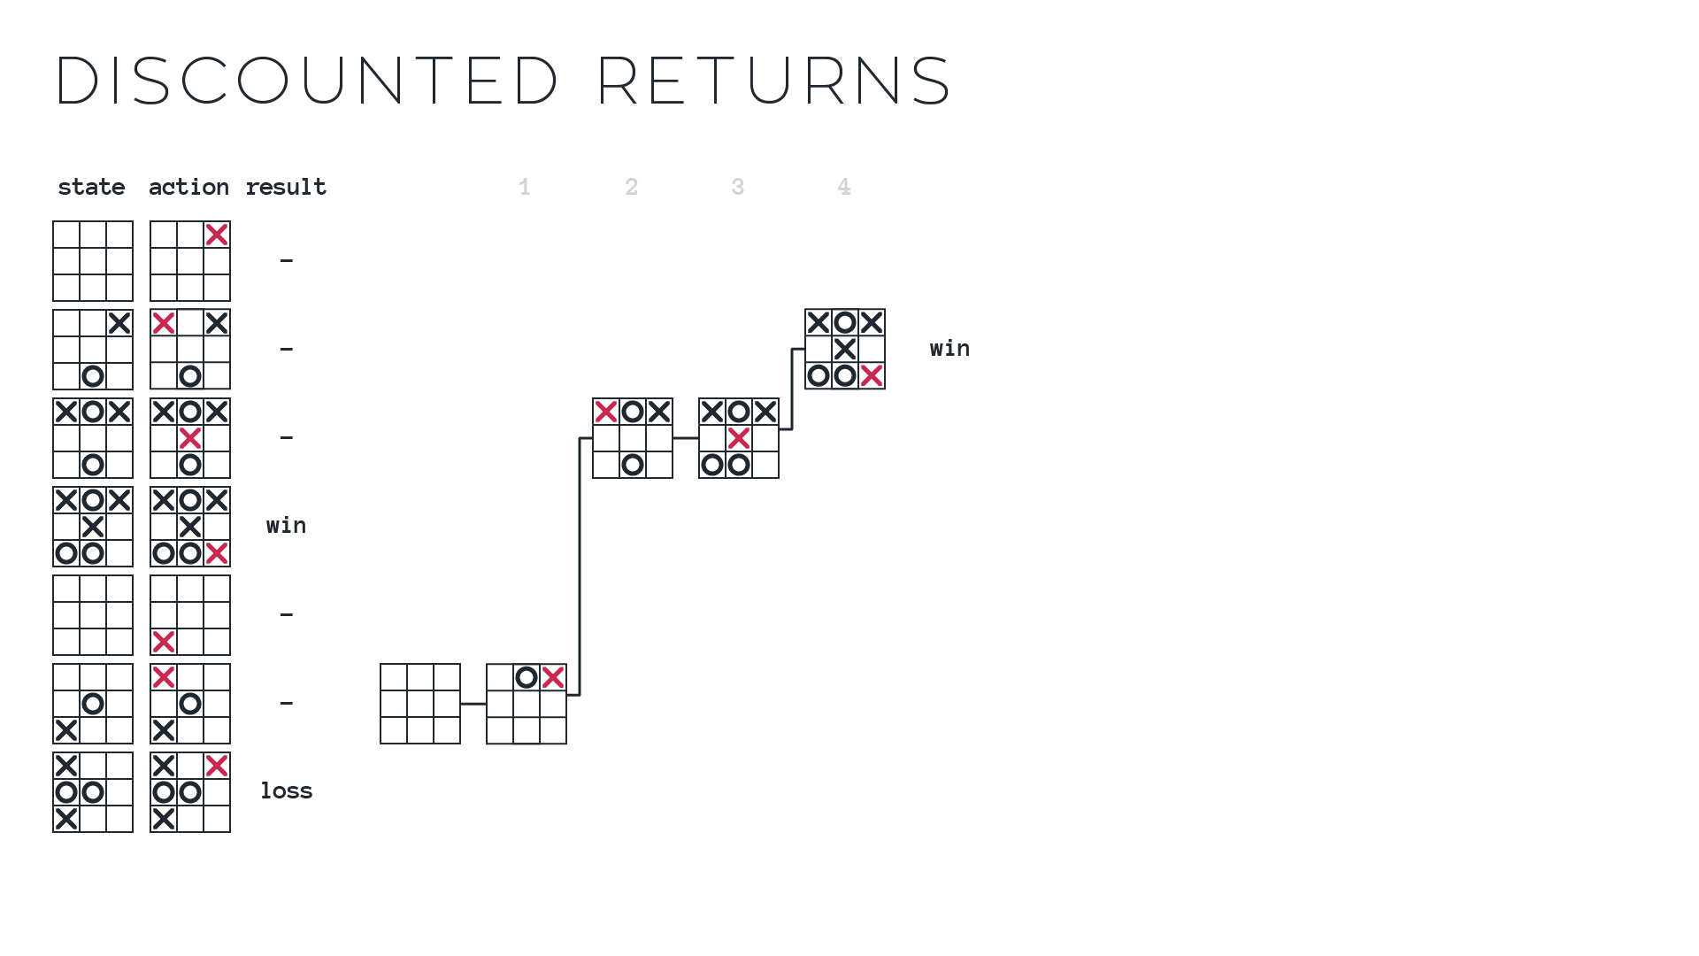
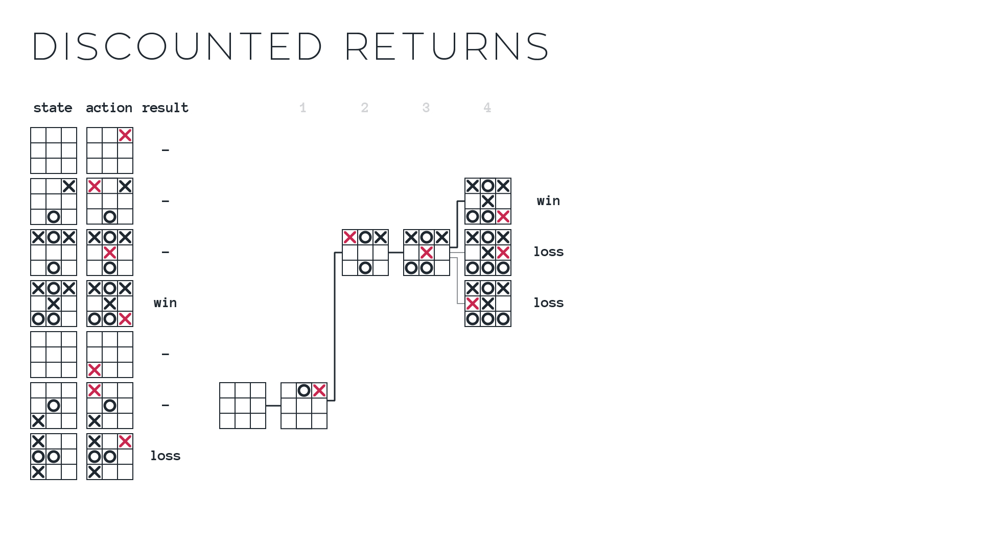

Slide 65


Slide 66
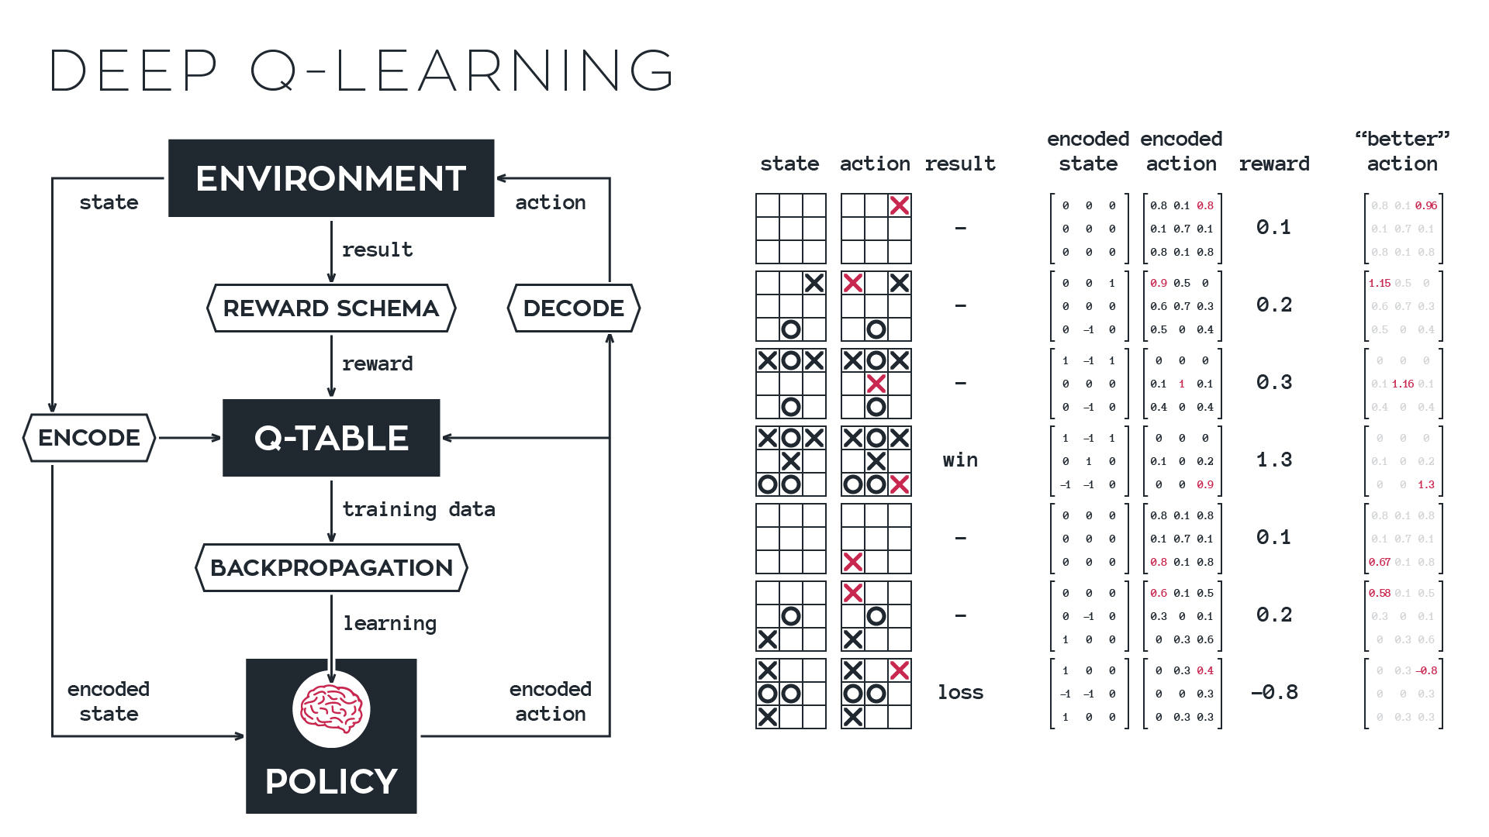
Notes:
SUMMARY SLIDE. End for morning tea here.

Slide 67
EPISODE
ITERATION

Slide 70
Notes:
- To get rid of green squiggly line, click Ctrl + Shift + p, type ‘Python: Change Linter’, and select ‘Disable Linter’.
- To change shell, open settings, search ‘Terminal Windows’, type in ‘C:\WINDOWS\System32\cmd.exe’

Slide 73


Slide 75


Slide 76
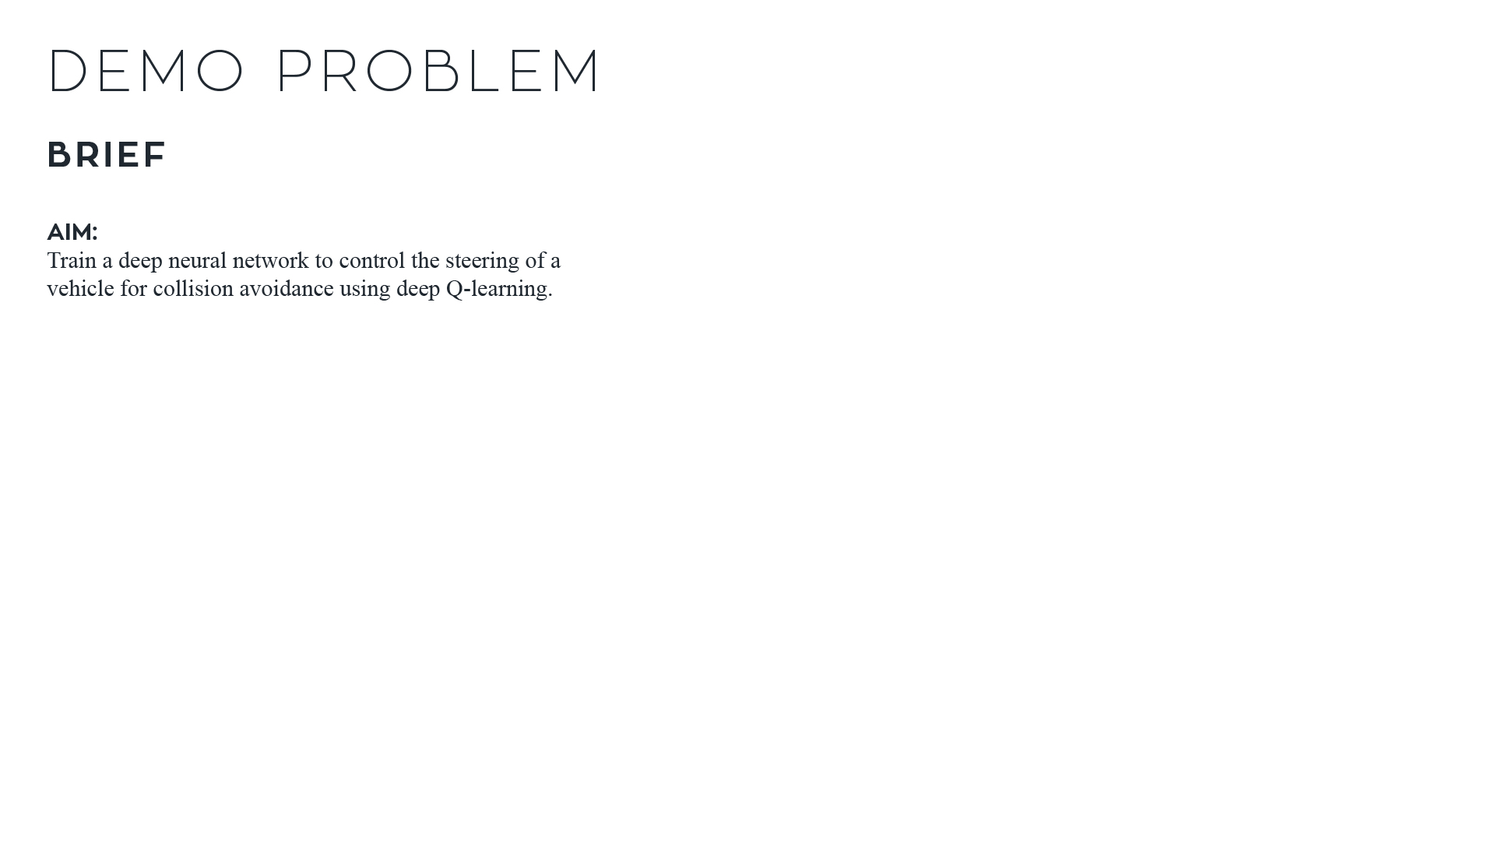
EPISODE
ITERATION

Slide 77
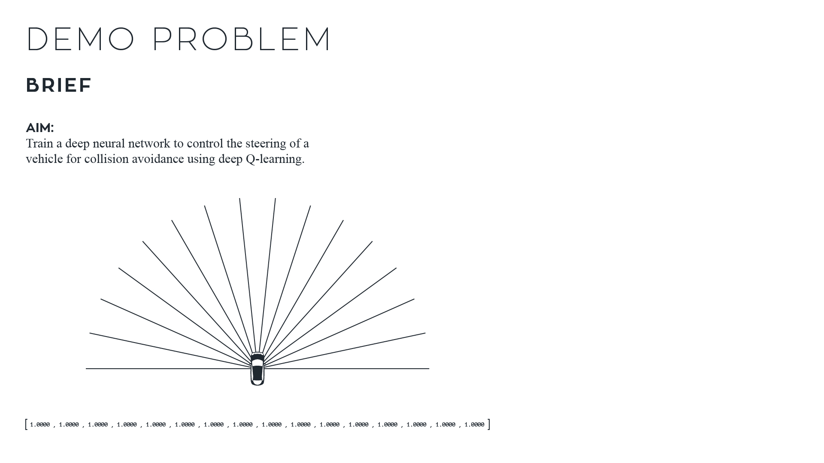
EPISODE
ITERATION

Slide 78
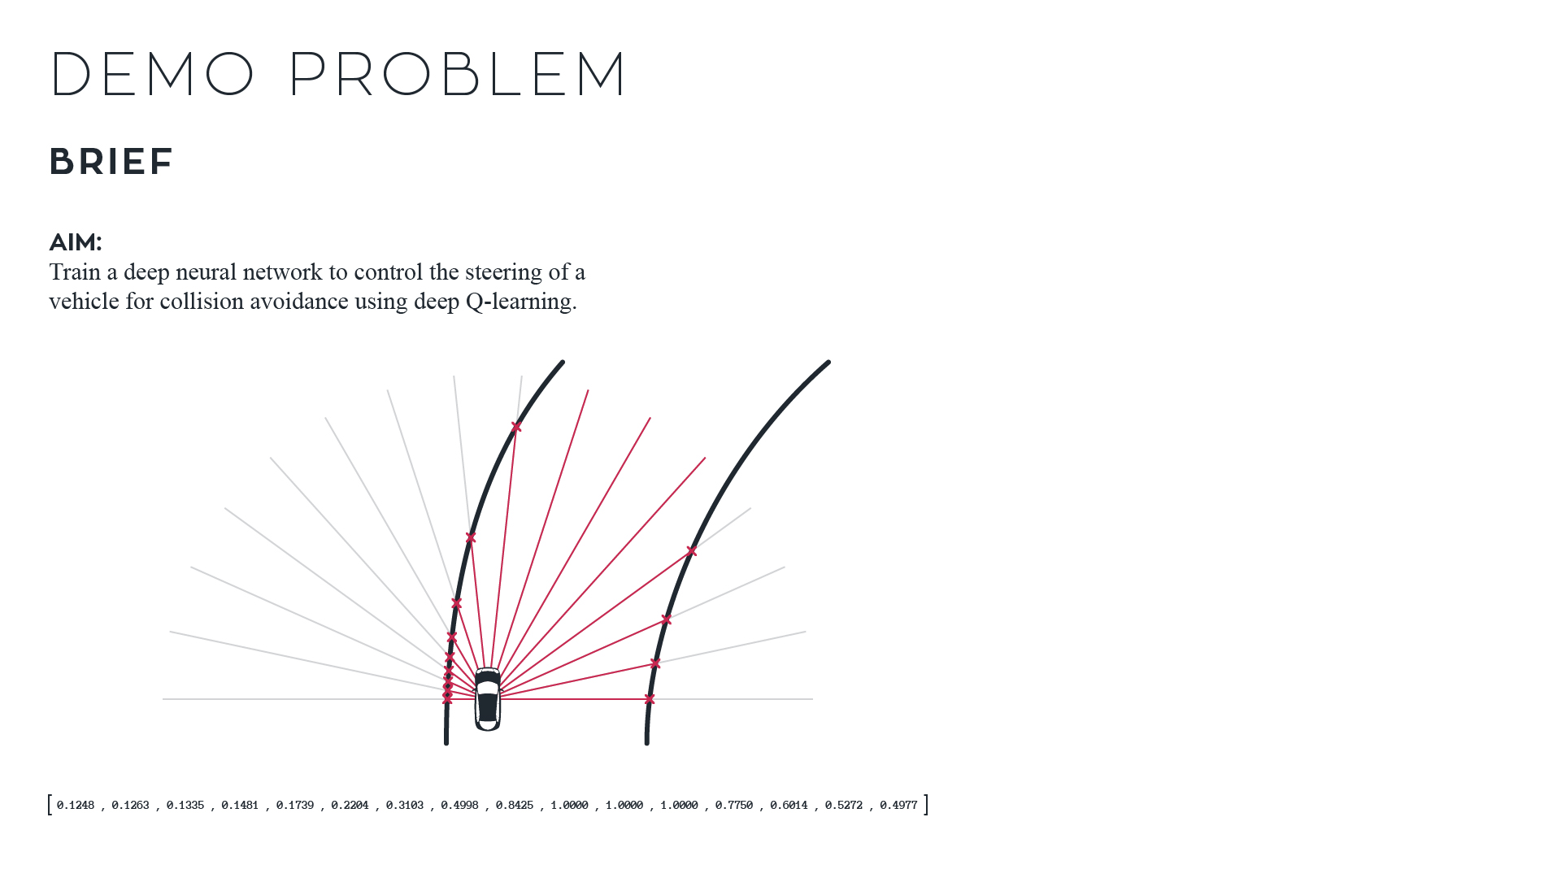
EPISODE
ITERATION

Slide 79
EPISODE
ITERATION

